Slide 1
Using Data Flow Diagrams
7
Kendall & Kendall Systems Analysis and Design, 9e
Notes:
1

Slide 2
Learning Objectives
Comprehend the importance of using logical and physical data flow diagrams (DFDs) to graphically depict movement for humans and systems in an organization.
Create, use, and explode logical DFDs to capture and analyze the current system through parent and child levels.
Develop and explode logical DFDs that illustrate the proposed system.
Produce physical DFDs based on logical DFDs you have developed.
Understand and apply the concept of partitioning of physical DFDs.

Slide 3
Data Flow Diagrams
Graphically characterize data processes and flows in a business system
Depict:
System inputs
Processes
Outputs
Notes:
A series of layered data flow diagrams may be used to represent and analyze detailed procedures in the larger system.

Slide 4
Major Topics
Data flow diagram symbols
Data flow diagram levels
Creating data flow diagrams
Physical and logical data flow diagrams
Partitioning
Communicating using data flow diagrams

Slide 5
Advantages of the Data Flow Approach
Freedom from committing to the technical implementation too early
Understanding of the interrelatedness of systems and subsystems
Communicating current system knowledge to users
Analysis of the proposed system

Slide 6
Basic Symbols
A double square for an external entity
An arrow for movement of data from one point to another
A rectangle with rounded corners for the occurrence of a transforming process
An open-ended rectangle for a data store

Slide 7
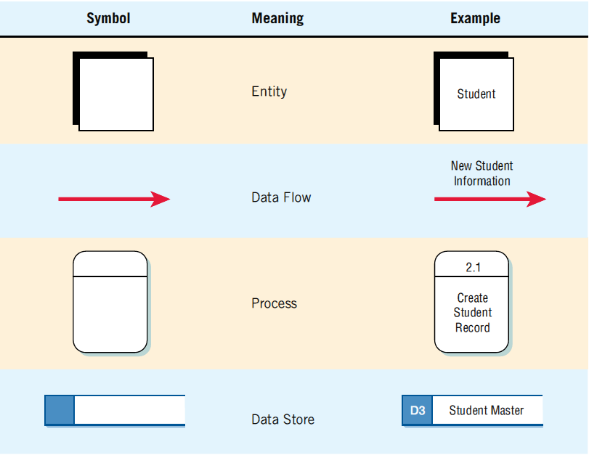
The Four Basic Symbols Used in Data Flow Diagrams, Their Meanings, and Examples (Figure 7.1)
Notes:
An entire system and numerous subsystems can be depicted graphically with these four symbols in combination.

Slide 8
External Entities
Represent another department, a business, a person, or a machine
A source or destination of data, outside the boundaries of the system
Should be named with a noun
Notes:
An external entity (outside the boundaries of the system) sends data to (source) or receives data from (destination) the system.
Each entity is labeled with a name, generally a noun.
The same entity may be used more than once on a given data flow diagram.

Slide 9
Data Flow
Shows movement of data from one point to another
Described with a noun
Arrowhead indicates the flow direction
Represents data about a person, place, or thing
Notes:
Data flows occurring simultaneously can be depicted doing just that through the use of parallel arrows.

Slide 10
Process
Denotes a change in or transformation of data
Represents work being performed in the system
Naming convention:
Assign the name of the whole system when naming a high-level process
To name a major subsystem attach the word subsystem to the name
Use the form verb-adjective-noun for detailed processes
Notes:
The data flow leaving a process is always labeled differently then the data flow entering the process.
A process must also be given a unique identifying number indicating its level in the diagram.

Slide 11
Data Store
A depository for data that allows examination, addition, and retrieval of data
Named with a noun, describing the data
Data stores are usually given a unique reference number, such as D1, D2, D3
Represents a:
Database
Computerized file
Filing cabinet
Notes:
Data stores represent a person, place, or thing which is why they are named with a noun.
Temporary data stores, such as scratch paper or a temporary computer file are not included on the data flow diagram.

Slide 12
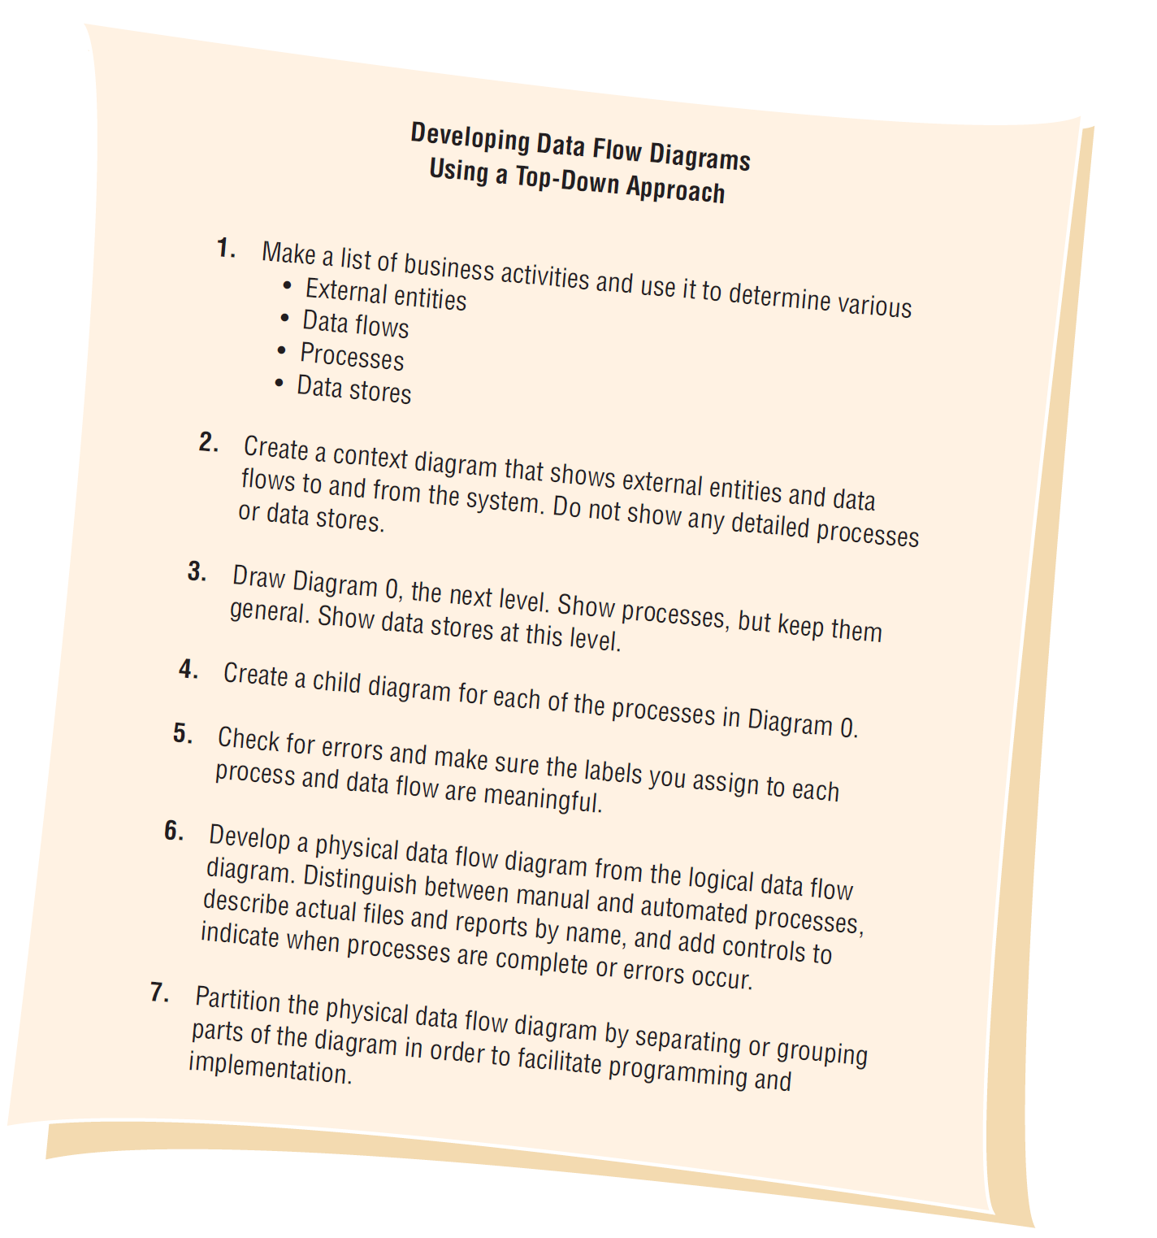
Steps in Developing Data Flow Diagrams (Figure 7.2)
Notes:
Data flow diagrams can and should be drawn systematically.
To begin a data flow diagram, collapse the organization’s system narrative into a list with four categories of external entity, data flow, process, and data store. This list helps determine the boundaries of the system. Next begin drawing the context diagram.

Slide 13
Creating the Context Diagram
The highest level in a data flow diagram
Contains only one process, representing the entire system
The process is given the number 0
All external entities, as well as major data flows are shown
Notes:
Basically the context diagram consists of:
one process—depicting the entire system
external entities
data flows from the external entities to the process
The diagram does not contain any data stores.

Slide 14
Basic Rules
The data flow diagram must have one process
Must not be any freestanding objects
A process must have both an input and output data flow
A data store must be connected to at least one process
External entities should not be connected to one another

Slide 15
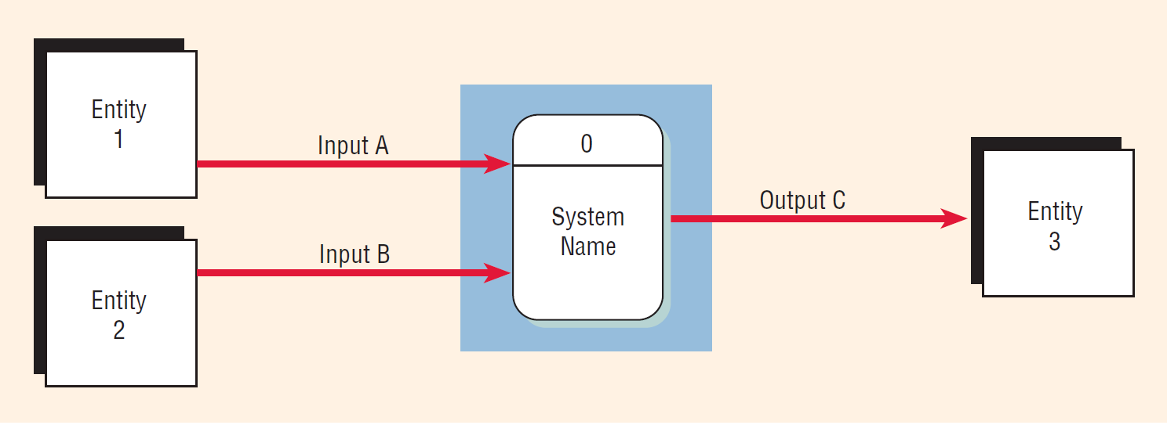
Context Diagram (Figure 7.3)

Slide 16
Drawing Diagram 0
The explosion of the context diagram
May include up to nine processes
Each process is numbered
Major data stores and all external entities are included
Notes:
Including more than nine processes will result in a cluttered diagram that is difficult to understand.
Each process is numbered with an integer, starting form the upper left-hand corner and working toward the lower right-hand corner.
Because a data flow diagram is two-dimensional, you can start at any point and work forward or backward through the diagram.

Slide 17
Drawing Diagram 0 (continued)
Start with the data flow from an entity on the input side
Work backward from an output data flow
Examine the data flow to or from a data store
Analyze a well-defined process
Take note of any fuzzy areas
Notes:
Because a data flow diagram is two-dimensional, you can start at any point and work forward or backward through the diagram.

Slide 18
Note Greater Detail in Diagram 0 (Figure 7.3)

Slide 19
Data Flow Diagram Levels
Data flow diagrams are built in layers
The top level is the context level
Each process may explode to a lower level
The lower level diagram number is the same as the parent process number
Processes that do not create a child diagram are called primitive

Slide 20
Creating Child Diagrams
Each process on diagram 0 may be exploded to create a child diagram
A child diagram cannot produce output or receive input that the parent process does not also produce or receive
The child process is given the same number as the parent process
Process 3 would explode to Diagram 3
Notes:
The process on Diagram 0 that is exploded is called the parent process, and the diagram that results is called the child diagram.
On Diagram 3, the processes would be numbered 3.1, 3.2, 3.3, and so on. This allows the analyst to trace a series of processes through many levels of explosion.

Slide 21
Creating Child Diagrams (continued)
Entities are usually not shown on the child diagrams below Diagram 0
If the parent process has data flow connecting to a data store, the child diagram may include the data store as well
When a process is not exploded, it is called a primitive process
Notes:
In addition, the lower-level diagram may contain data stores not shown on the parent process.

Slide 22
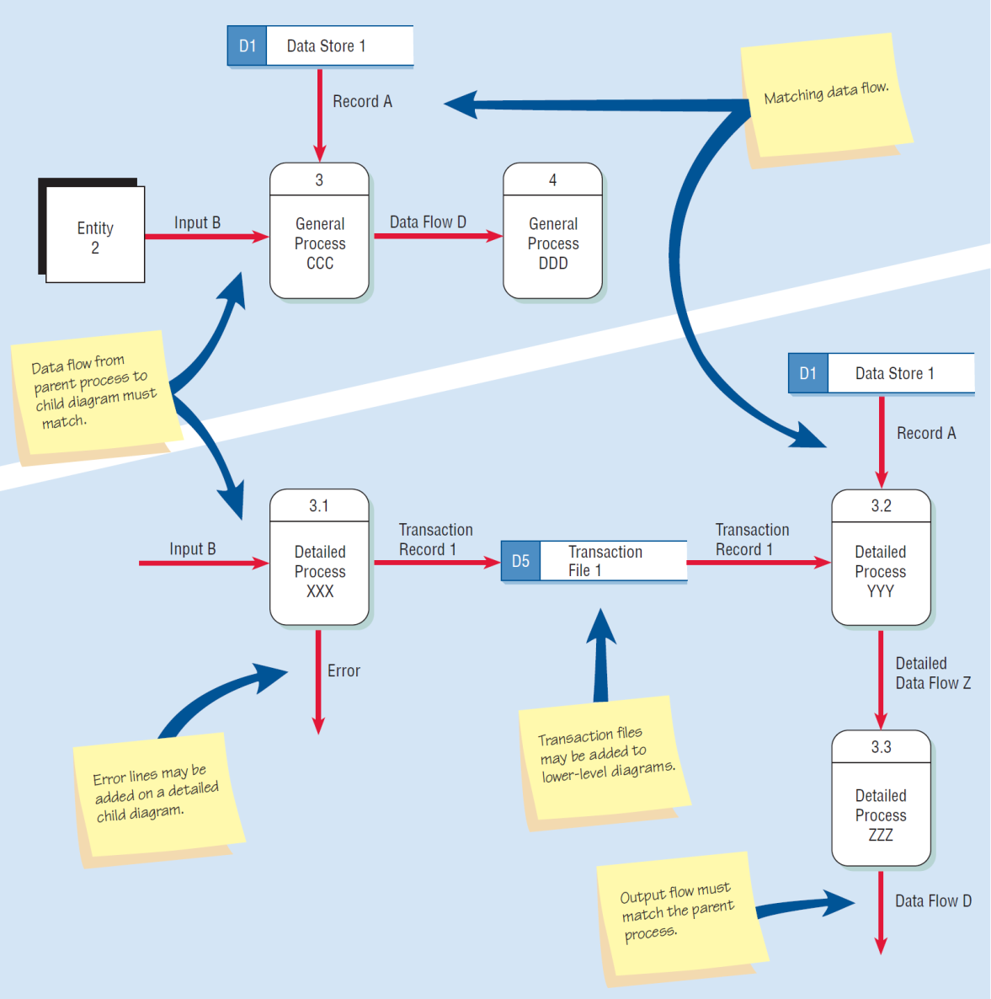
Differences between the Parent Diagram (above) and the Child Diagram (below) (Figure 7.4)

Slide 23
Data Flow Diagrams Error Summary
Forgetting to include a data flow or pointing an arrow in the wrong direction
Connecting data stores and external entities directly to each other
Incorrectly labeling processes or data flow

Slide 24
Data Flow Diagrams Error Summary (continued)
Including more than nine processes on a data flow diagram
Omitting data flow
Creating unbalanced decomposition (or explosion) in child diagrams

Slide 25
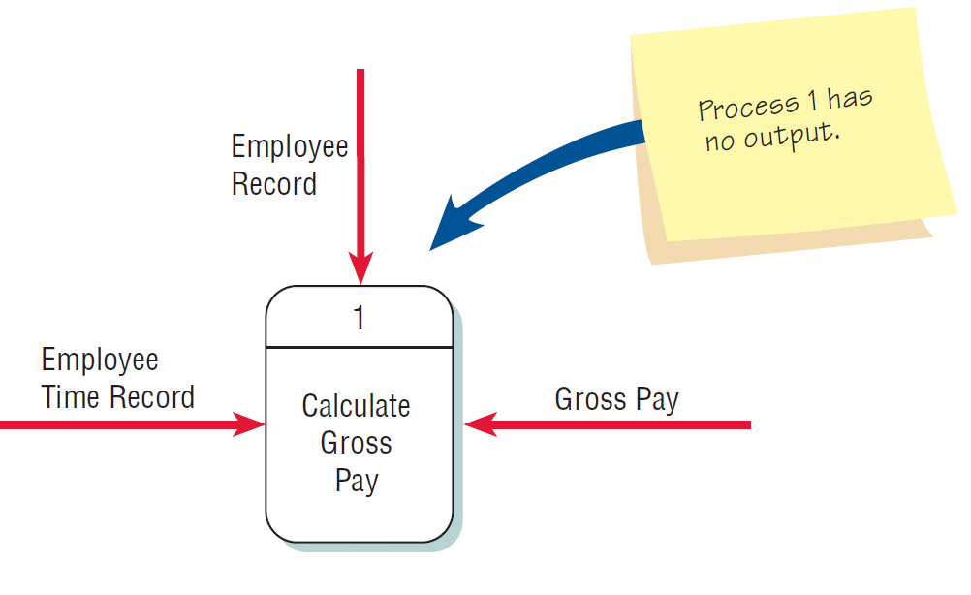
Checking the Diagrams for Errors (Figure 7.5)
Forgetting to include a data flow or pointing an arrow in the wrong direction

Slide 26
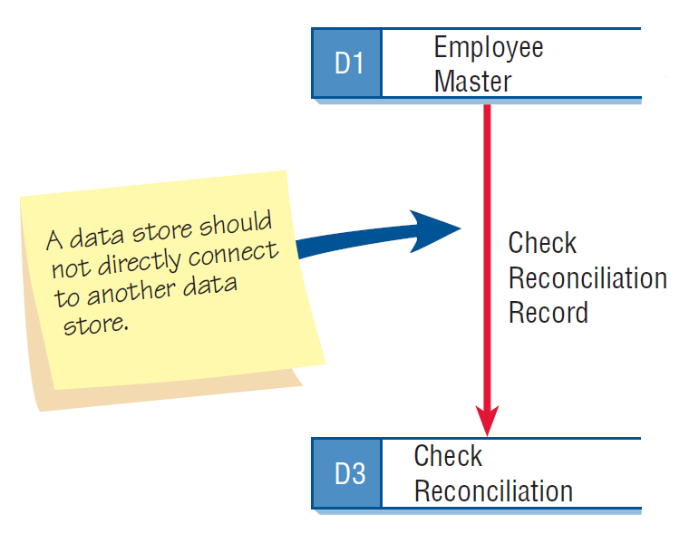
Checking the Diagrams for Errors (continued Figure 7.5)
Connecting data stores and external entities directly to each other

Slide 27
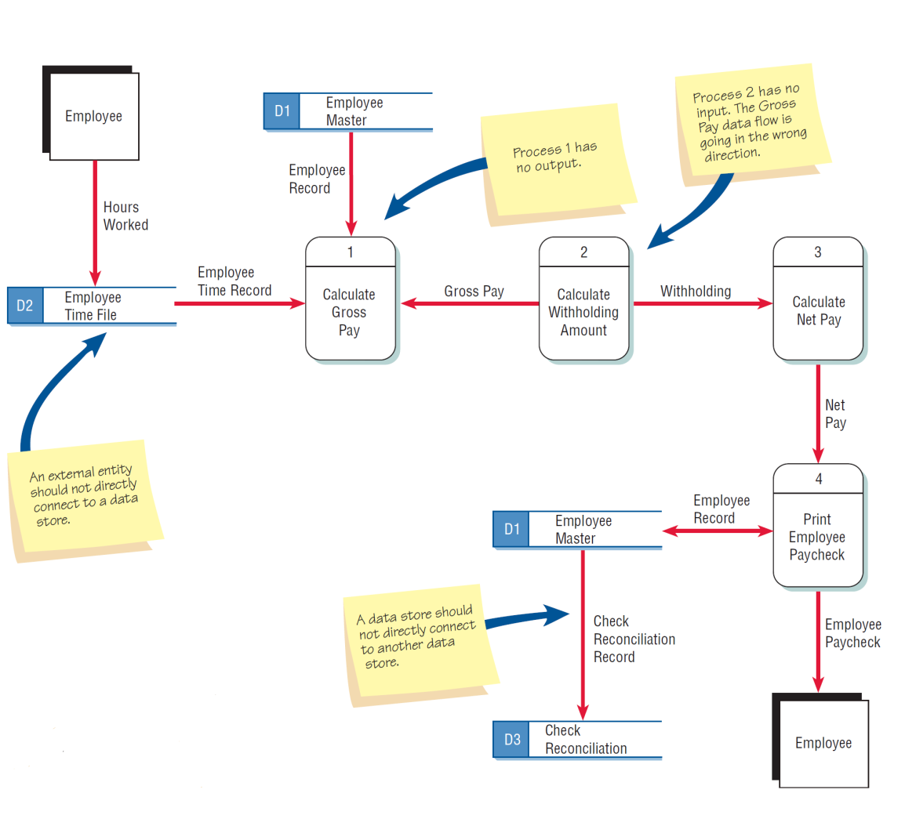
Typical Errors that Can Occur in a Data Flow Diagram (Payroll Example) (continued Figure 7.5)

Slide 28
Logical and Physical Data Flow Diagrams
Logical
Focuses on the business and how the business operates
Not concerned with how the system will be constructed
Describes the business events that take place and the data required and produced by each event

Slide 29
Logical and Physical Data Flow Diagrams
Physical
Shows how the system will be implemented
Depicts the system

Slide 30
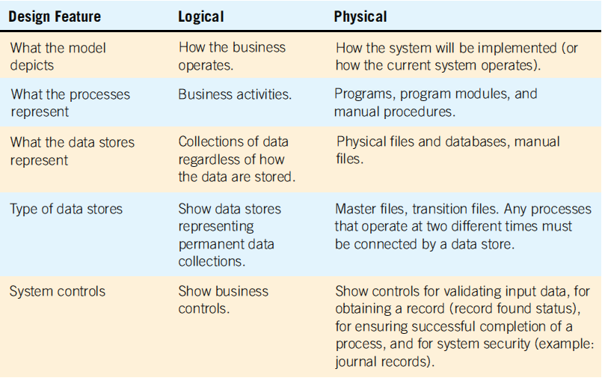
Features Common of Logical and Physical Data Flow Diagrams (Figure 7.7)

Slide 31
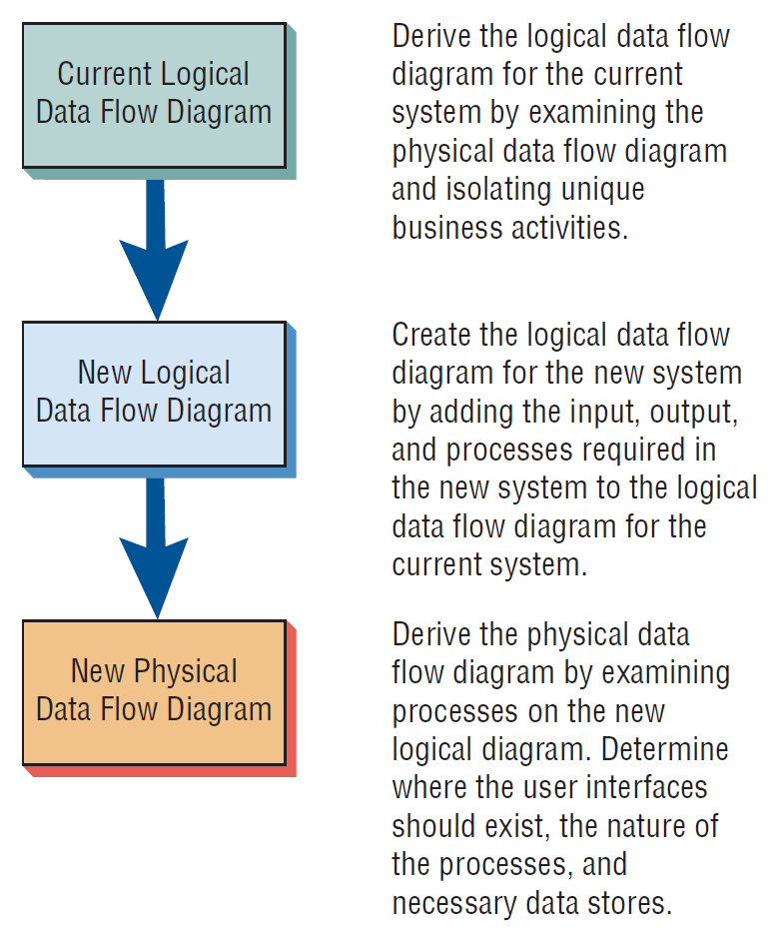
The Progression of Models from Logical to Physical (Figure 7.8)
Notes:
The progression of creating data flow diagrams is:
Analyze the current system (current logical DFD).
Add features the new system should include (the proposed logical DFD).
Finally the best methods for implementing the new system should be developed (the physical DFD).

Slide 32
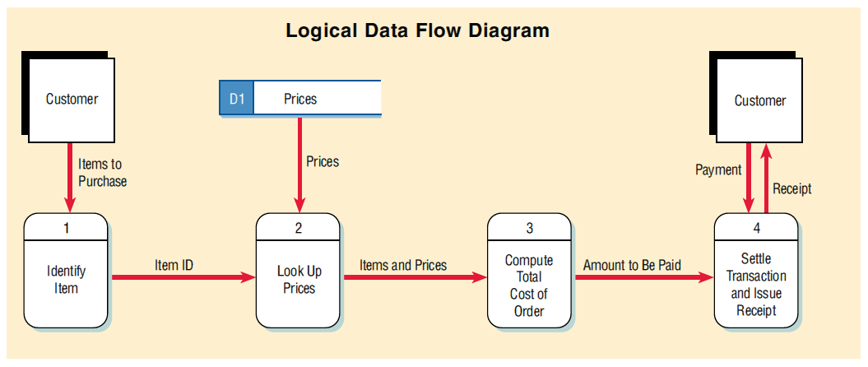
Logical Data Flow Diagram Example (Figure 7.9)

Slide 33
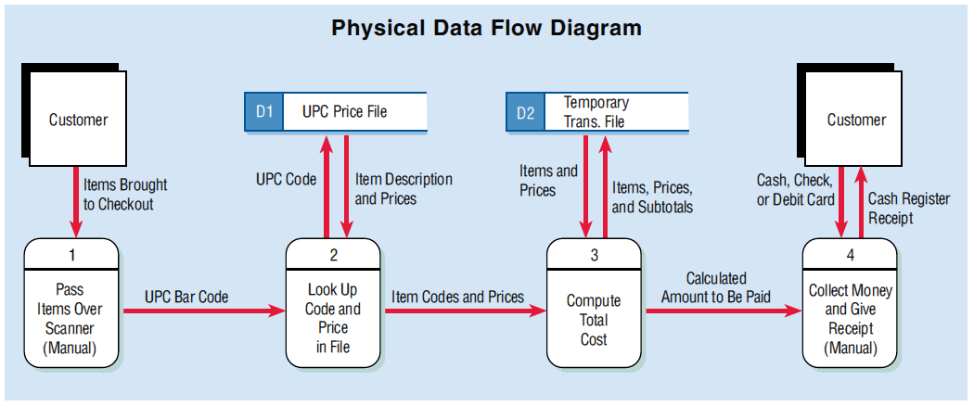
Physical Data Flow Diagram Example (Figure 7.9)

Slide 34
Developing Logical Data Flow Diagrams
Better communication with users
More stable systems
Better understanding of the business by analysts
Flexibility and maintenance
Elimination of redundancy and easier creation of the physical model
Notes:
Better communication with users—centered on business activities.
More stable systems—based on business events and not on a particular technology or method of implementation.

Slide 35
Developing Physical Data Flow Diagrams
Clarifying which processes are performed by humans and which are automated
Describing processes in more detail
Sequencing processes that have to be done in a particular order
Identifying temporary data stores
Specifying actual names of files and printouts
Adding controls to ensure the processes are done properly

Slide 36
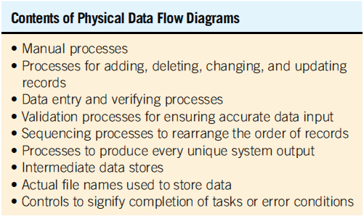
Physical Data Flow Diagrams Contain Many Items Not Found in Logical Data Flow Diagrams (Figure 7.10)
Notes:
Physical data flow diagrams are often more complex than logical data flow diagrams simply because of the many data stores present in the system.
The acronym CRUD is used for Create, Read, Update, and Delete.
A CRUD matrix shows which programs or processes add, read, update, or delete master file records.
Intermediate data stores—consist of transaction files used to store data between processes.
A physical data flow diagram may appear more linear that a logical model.

Slide 37
CRUD Matrix
The acronym CRUD is often used for
Create
Read
Update
Delete
These are the activities that must be present in a system for each master file
A CRUD matrix is a tool to represent where each of these processes occurs in a system

Slide 38
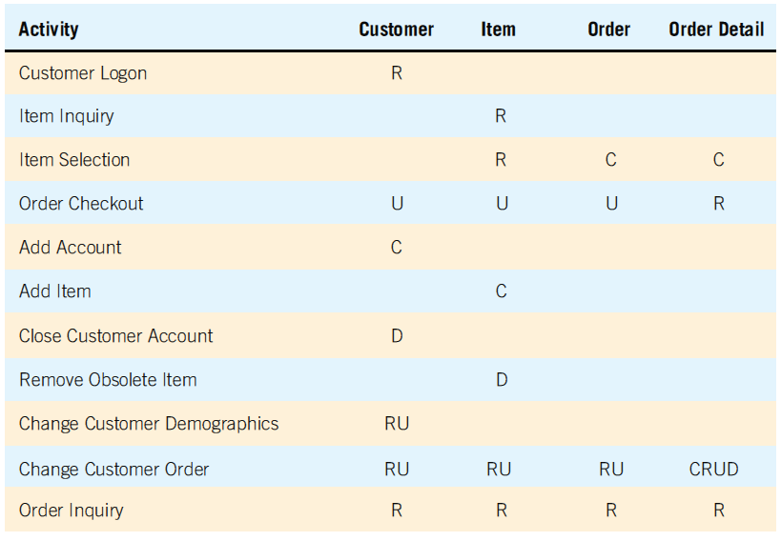
CRUD Matrix (Figure 7.11)

Slide 39
Event Modeling and Data Flow Diagrams
An input flow from an external entity is sometimes called a trigger because it starts the activities of a process
Events cause the system to do something and act as a trigger to the system
An approach to creating physical data flow diagrams is to create a data flow diagram fragment for each unique system event
Notes:
Triggers start activities or processes, which in turn use data or produce output.

Slide 40
Event Response Tables
An event table is used to create a data flow diagram by analyzing each event and the data used and produced by the event
Every row in an event table represents a data flow diagram fragment and is used to create a single process on a data flow diagram

Slide 41
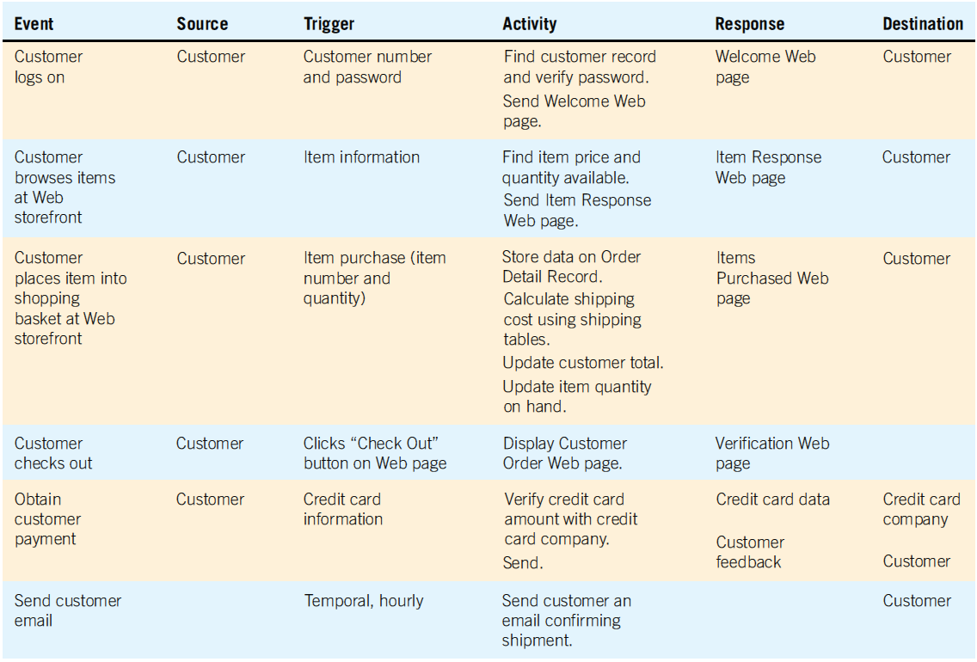
An Event Response Table for an Internet Storefront (Figure 7.12)

Slide 42
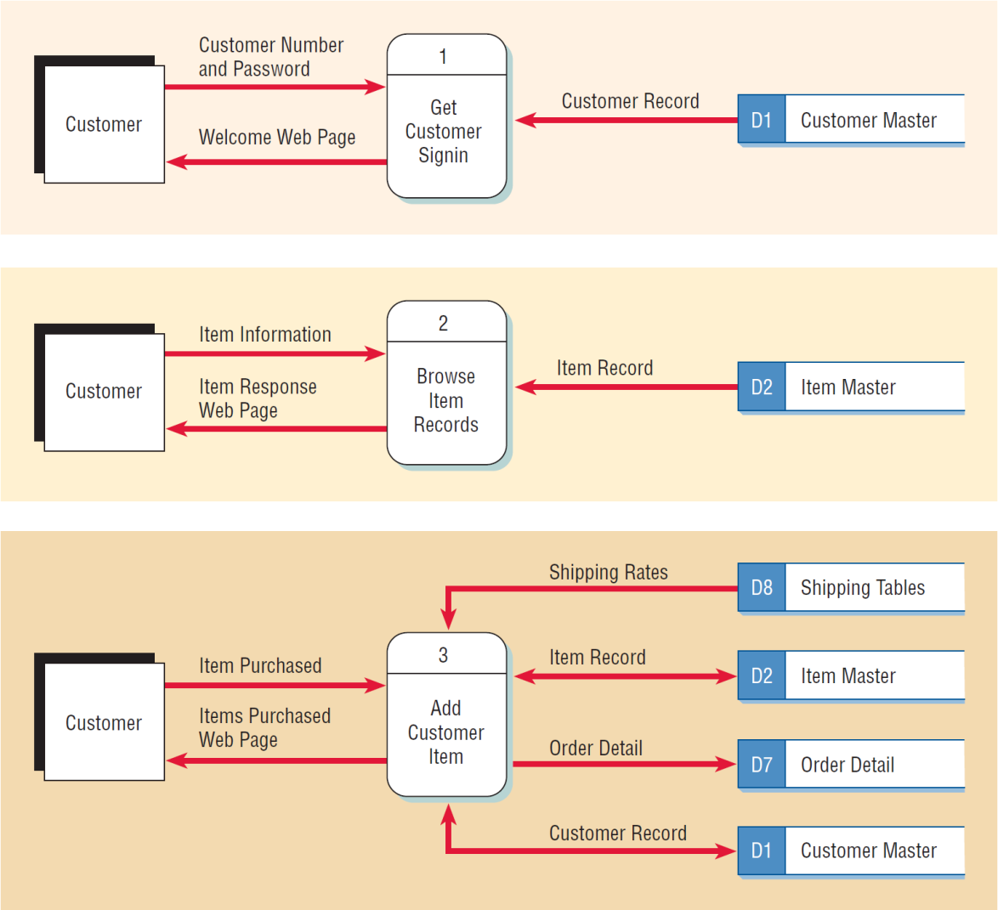
Data Flow Diagrams for the First Three Rows of the Internet Storefront Event Response Table (Figure 7.13)
Notes:
A dataflow diagram fragment is represented by one row in the table.
Each DFD fragment is a single process on a data flow diagram.
All the fragments are then combined to form Diagram 0.
The trigger and response column becomes the input and output data flows.
The activity becomes the process.
The data stores are determined by examining the input and output data flows.
The advantage of building data flow diagrams based on events is that the users are familiar with the events that take place in their business area and know how the events drive other activities.

Slide 43
Use Cases and Data Flow Diagrams
Each use case defines one activity and its trigger, input, and output
Allows the analyst to work with users to understand the nature of the processes and activities and then create a single data flow diagram fragment

Slide 44
Partitioning Data Flow Diagrams
Partitioning is the process of examining a data flow diagram and determining how it should be divided into collections of manual procedures and computer programs
A dashed line is drawn around a process or group of processes that should be placed in a single computer program
Notes:
Analyze each process to determine whether it should be a manual or automated procedure.
Group automated procedures into a series of computer programs.

Slide 45
Reasons for Partitioning
Different user groups
Timing
Similar tasks
Efficiency
Consistency of data
Security
Notes:
Different user groups—are the processes performed by several different user groups, often at different physical locations in the company? If so, they should be partitioned into different computer programs.
Timing—processes that execute at different times must be in separate programs
Similar tasks—may be included in the same program.
Efficiency—several batch processes may be included in the same program for efficiency.
Consistency—several processes may be included in the same program or job stream for consistency of data.
Security—may be partitioned into different programs for security reasons.

Slide 46
Partitioning Websites
Improves the way humans use the site
Improves speed of processing
Ease of maintaining the site
Keep the transaction secure
Notes:
Each time data must be obtained from a data store or an external partner, a website designer might consider creating a unique Web form and DFD process to validate and process the data or may also use Ajax, sending a request to the server and obtain a small amount of data or an XML document returned to the same page.

Slide 47
Communicating Using Data Flow Diagrams
Use unexploded data flow diagrams early when ascertaining information requirements
Meaningful labels for all data components
Notes:
Use unexploded data flow diagrams early when ascertaining information requirements—at this stage they can provide an overview of data movement through the system, lending a visual perspective unavailable in narrative data.
Meaningful labels for all data components—labels should not be generic.
Data flow diagrams can be used for documenting high and low levels of analysis and helping to substantiate the logic underlying the data flows of the organizations.

Slide 48
Summary
Data flow diagrams
Structured analysis and design tools that allow the analyst to comprehend the system and subsystems visually as a set of interrelated data flows
DFD symbols
Rounded rectangle
Double square
An arrow
Open-ended rectangle

Slide 49
Summary (continued)
Creating the logical DFD
Context-level data flow diagram
Level 0 logical data flow diagram
Child diagrams
Creating the physical DFD
Create from the logical data flow diagram
Partitioned to facilitate programming

Slide 50
Summary (continued)
Partitioning data flow diagrams
Whether processes are performed by different user groups
Processes execute at the same time
Processes perform similar tasks
Batch processes can be combined for efficiency of data
Processes may be partitioned into different programs for security reasons

Slide 51

Copyright © 2014 Pearson Education, Inc.
Publishing as Prentice Hall

